Slide 1
CV (DIP Extras)
Asif Rajput

Slide 2
Today’s Plan
Morphological Operations
Erosion & Dilation
Opening & Closing
Hit or Miss Transform

Slide 3

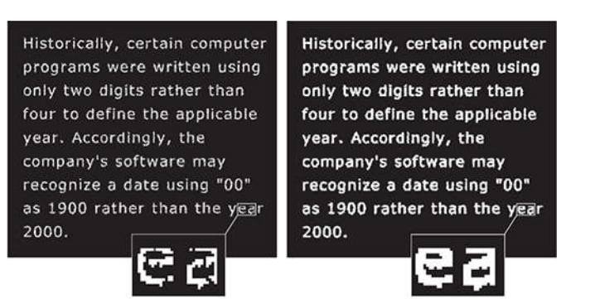
Utilities

Slide 4



Slide 5
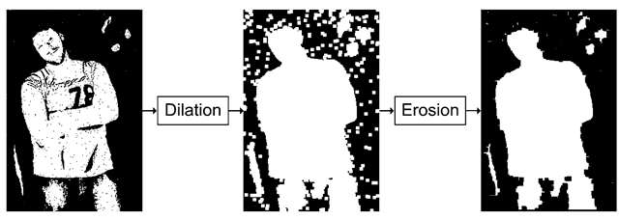
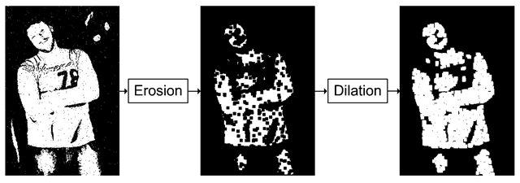

Slide 6
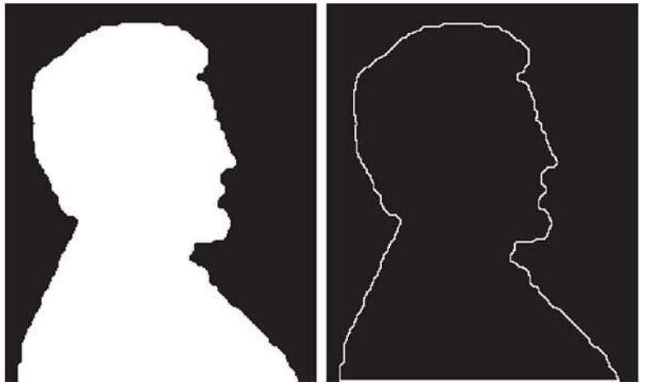

Slide 7


Slide 8
Preliminaries
Mathematical Morphological Operations
  Set theory
    Sets may represents objects in images
  Binary Image
    Sets are 2-D integer space Z²
    Each element of set is a tuple (coordinates of an object)
      Foreground object (assume its value is 1)
Morphological operations are defined in terms of sets
  Objects: sets of foreground pixels
  Structuring Elements: contains foreground, background and dont care pixels

Slide 9
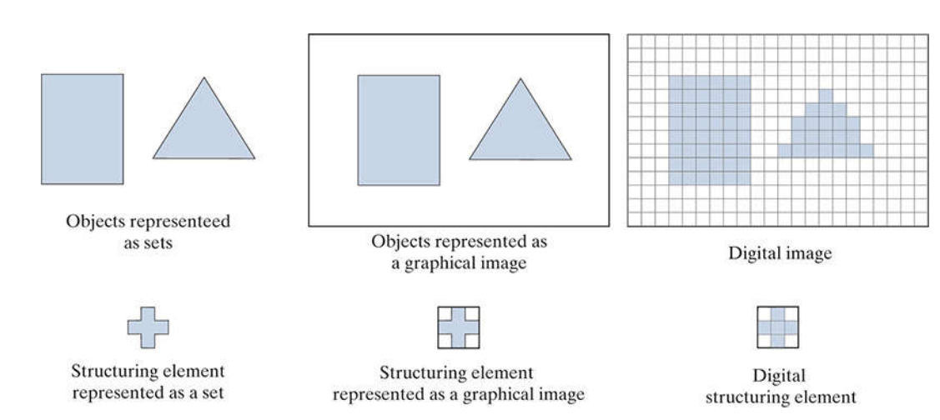
Preliminaries
Images are rectangular
  Sets with object pixels
  Sets with background pixels

Slide 10

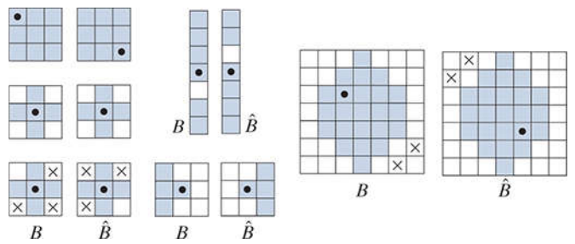

Preliminaries
Set Reflection of structuring element, about its origin
Set translation
  A point z=(z₁,z₂)
  Slide a SE over an image

Slide 11


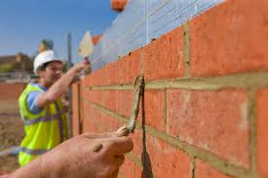
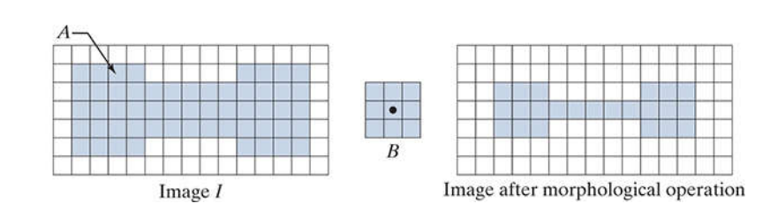
Example
Image A, SE B
From a new Image
  Slide B over A
    If B is completely contained in A call it foreground
      Completely contained: Fg elements of A overlaps completely with B

Slide 12


Erosion & Dilation
Erosion
Morphological
expression
  Fg A
  SE B (B only has Fg elements)
  Erosion of A by B
Output is an image, with Bg pixels (B can have Bg Elements)

Slide 13

Erosion & Dilation
Output is an image, with Bg pixels (B can have Bg Elements)
Another way of writing erosion
  B contining in A means B sharing no element with background i.e. A^{c}

Slide 14
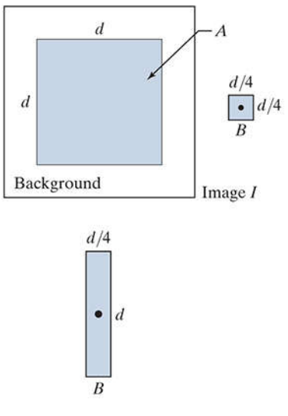

Slide 15
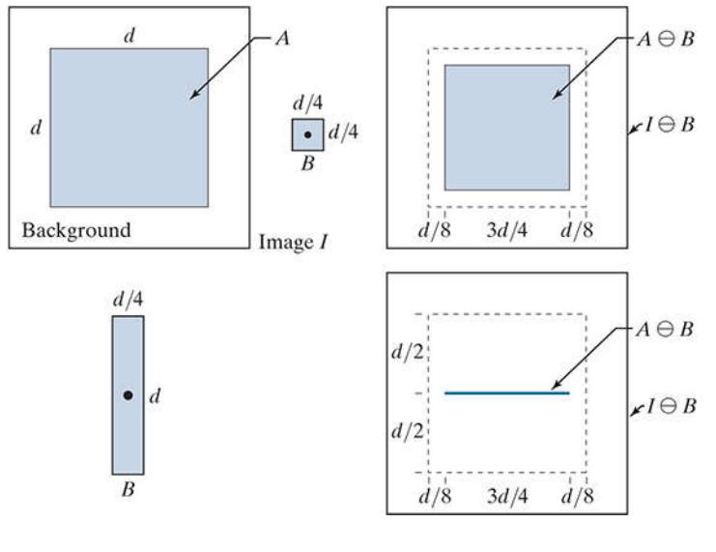

Slide 16
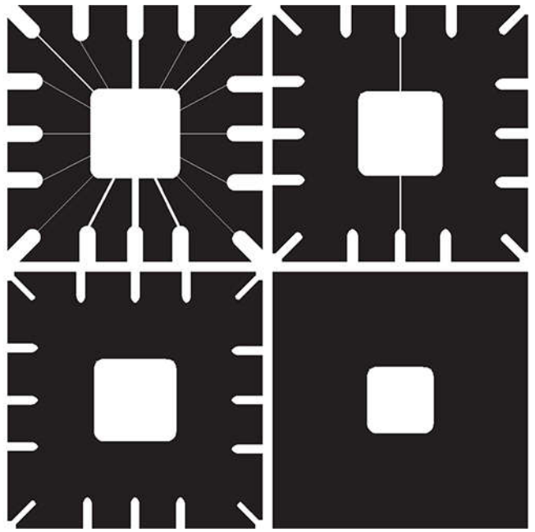
Example Erosion
Remove connecting line
  11x11
  15x15
  45x45

Slide 17
Example Erosion
Erosion shrinks or thins objects in binary image
Image details smaller than SE are filtered (removed)

Slide 18


Dilation
Dilation of A by B
Reflect B
Translate by z
set of all displacements, z, such that the fg of B^ overlap at least one element of A

Slide 19
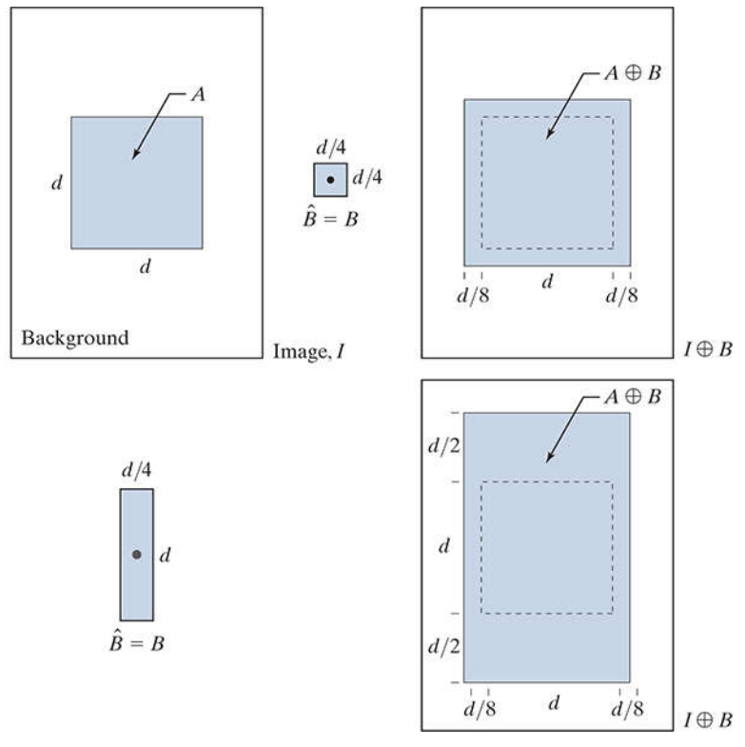

Slide 21
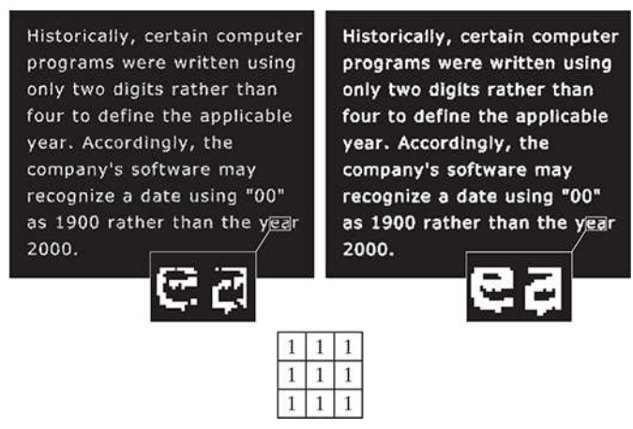
Example
Length of Breaks is 2 pixels

Slide 22
Example
Expands or thickens object in images

Slide 23
Opening and Closing
Opening
  Smoothes contours of an object
  Breaks narrow isthmuses
  Eliminate thin protrusions

Slide 24
Opening and Closing
Opening
  Smoothes contours of an object
  Breaks narrow isthmuses
  Eliminate thin protrusions
A ∘ B = ( A ⊖ B )⊕ B

Slide 25

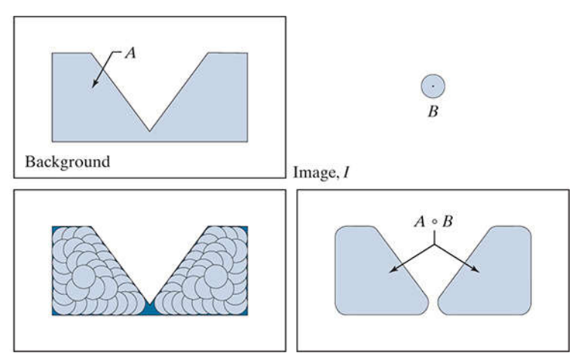
Opening
Union of all translations of B, so that B contained in A
  e.g. B cannot fit in narrow segment

Slide 26
Opening and Closing
Closing
  smooth sections of contours
  Fuses narrow breaks and long thin gulfs
  Eliminate small holes and fill gaps in contours
    A • B = ( A ⊕ B ) ⊖ B

Slide 27
Opening and Closing
Closing
  smooth sections of contours
  Fuses narrow breaks and long thin gulfs
  Eliminate small holes and fill gaps in contours
    A • B = ( A ⊕ B ) ⊖ B

Slide 28

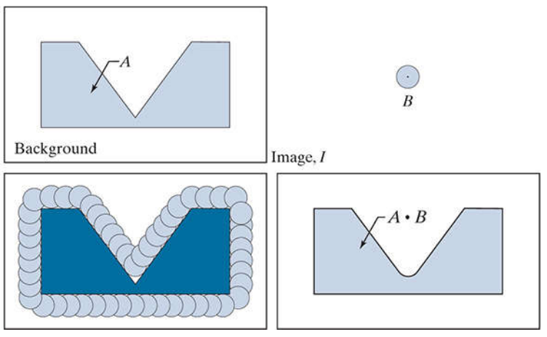
Complement of the Union of all translations of B that do not overlap A
  Boundary of the closing is determined by the furthest points B could reach without going inside any part of A

Slide 29
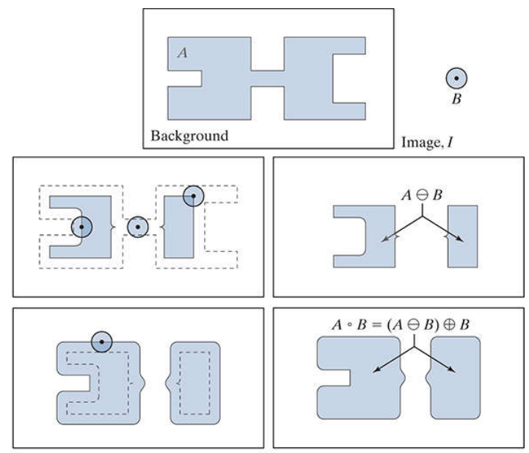
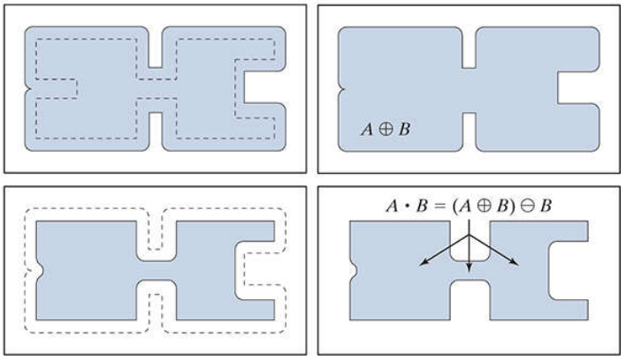

Slide 30
Remove parts where disk does not fit in protruding object
  Smooth the contours
  Remove thin protrusions
  Break thin connections
Closing
  Join narrow breaks
  Fill objects smaller than the disk

Slide 31

Morphological filtering

Slide 32
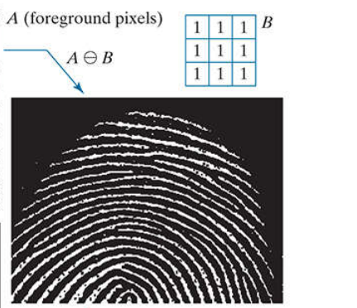


Morphological filtering

Slide 33
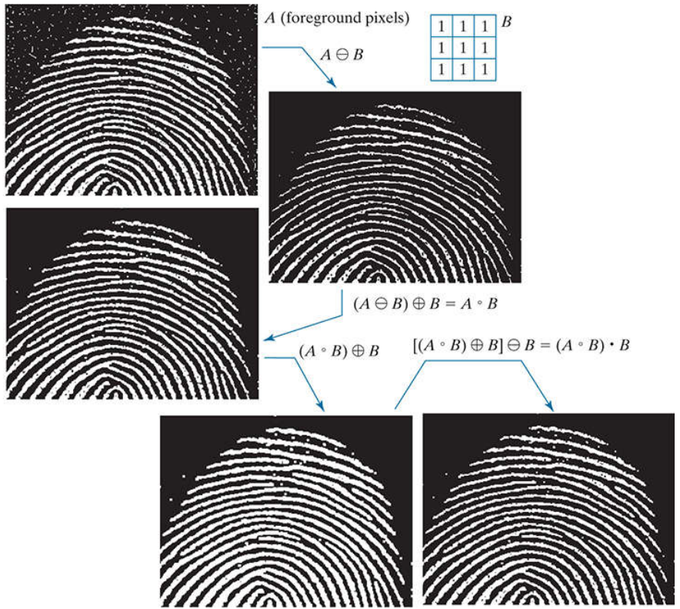
Morphological filtering

Slide 34

Hit-or-Miss Transform
Hit-or-Miss transform
  Shape detection
  HMT uses two SE for shape detection
    B1 for detecting shapes in fg
    B2 for detecting shapes in bg
  set of translations, z, of structuring elements B1 and B2 such that, Simultaneously,
    B1 found a match in the fg
    B2 found a match in bg
    z is same translation of B1 and B2

Slide 35
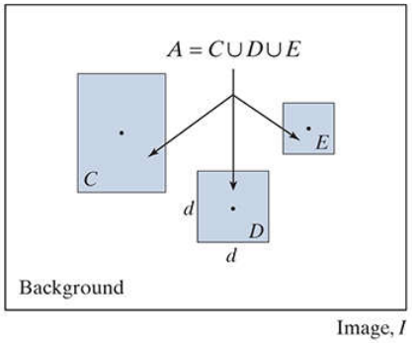
Hit-or-Miss Transform
Find the location of the origin of object D
A is union of all three objects
  D is subset of A
All three objects in A occupy different
area of background
  Nature of the shape is determined
  by geometrical arrangements of fg
  and bg

Slide 36
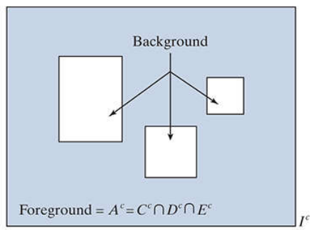
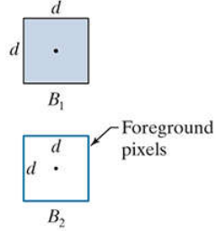
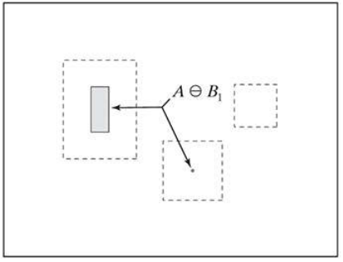
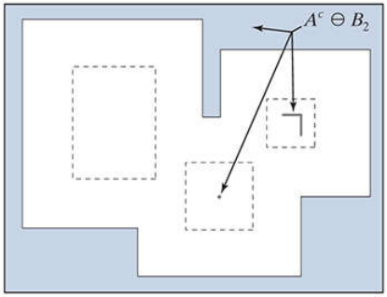
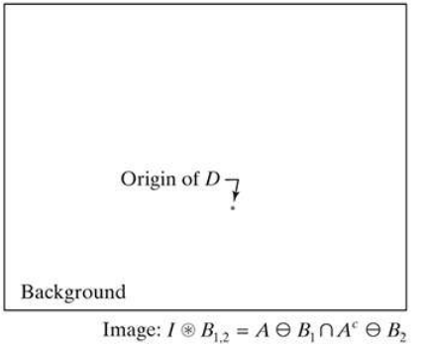

Slide 37

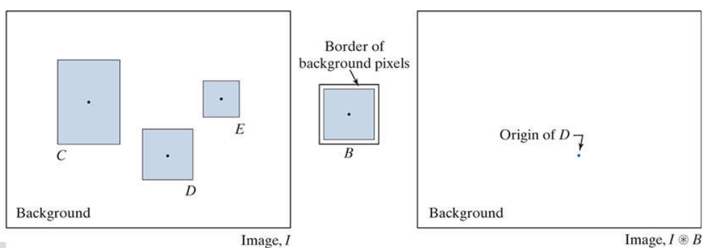
HMT
Is there are simpler way ?
  Erosion is defined with foreground pixels
Process fg and bg pixels simultaneously

Slide 38
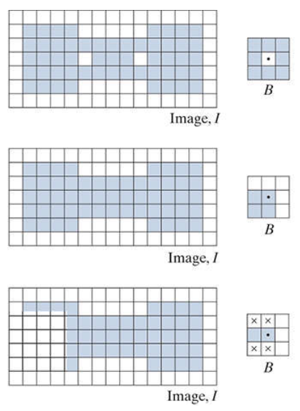

Slide 39
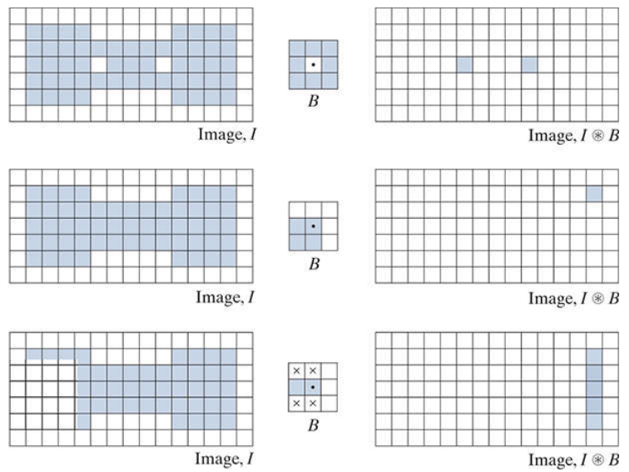

Slide 40
Boundary Extraction

Slide 41
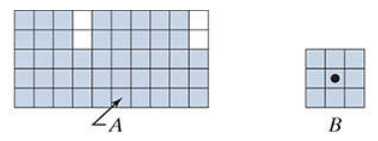
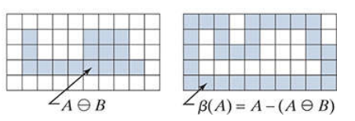
Boundary Extraction
Erode A with some suitable SE
  Subtract eroded image from Original

Slide 42
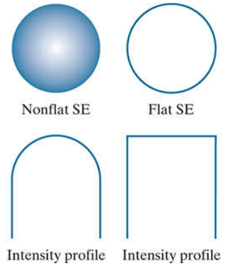
Grayscale Morphological Ops
SE
  Flat:
  Non-flat:

Slide 43


Grayscale Erosion & Dilation (Flat)
The grayscale erosion of f by a flat structuring element b at location (x, y)
  the minimum value of the image in the region coincident with b(x, y) when the origin of b is at (x, y)
  Size/intensity of bright features reduced and dark features increased (reverse for dilation)
grayscale dilation of f by a flat structuring element b at any location (x, y)

Slide 44

Image 448x425 pixels
Erosion
Dilation

Slide 45
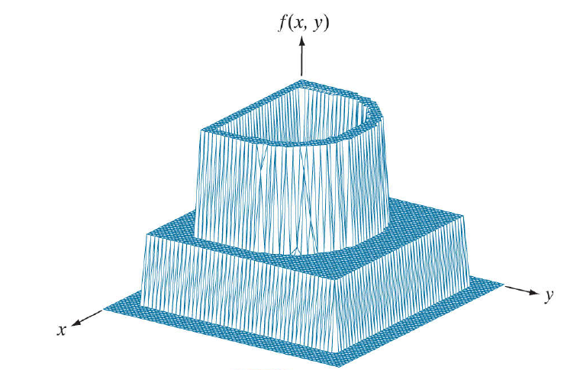
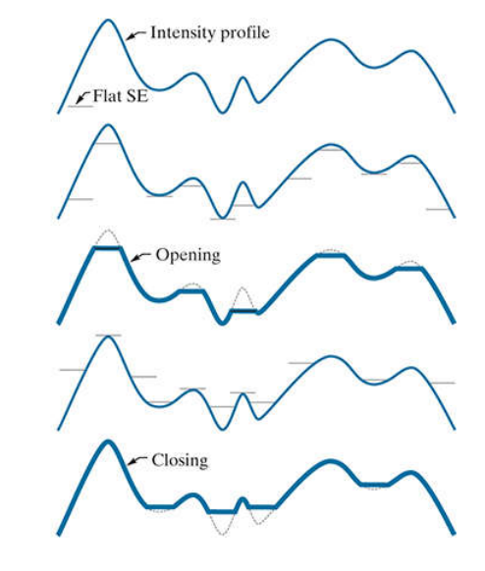


Grayscale (Non-Flat SE)
Erosion
  Its not bounded by the values of f
  Need to be very careful with b_{N}
Dilation
Opening
Closing

Slide 46
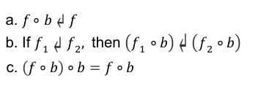

Grayscale Opening and Closing
Properties of Opening
  suppresses bright details smaller than the specified SE, while leaving dark details relatively unaffected
Properties of closing
What if you apply one after another?

Slide 47
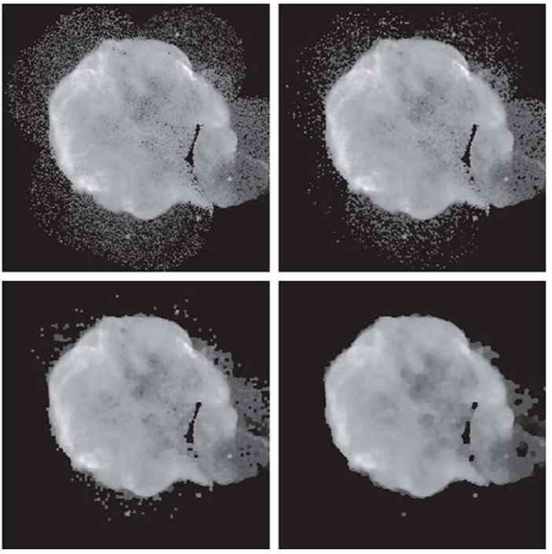
Morphological Smoothing
X-ray taken from NASA Hubel Telescope
Opening and closing with three different radius

Slide 48
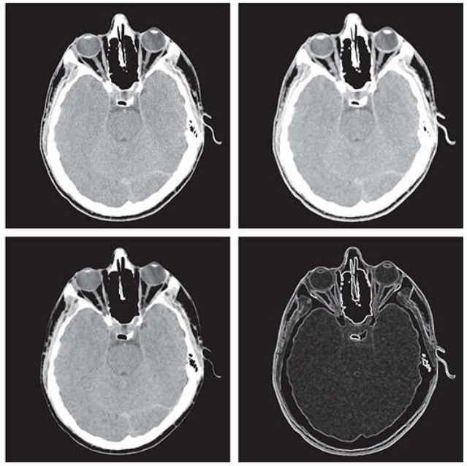
Morphological Gradient
What did we use gradient for ?

Slide 49


Top-Hat, Bottom-Hat Transformation
Use an additional subtraction operation with opening or closing
An intuition behind this is
  Open and close operation removes objects that does not fit with SE
  Subtraction from the original gives the removed components only
  Used for light objects on dark bg
    correcting the effects of nonuniform illumination

Slide 50
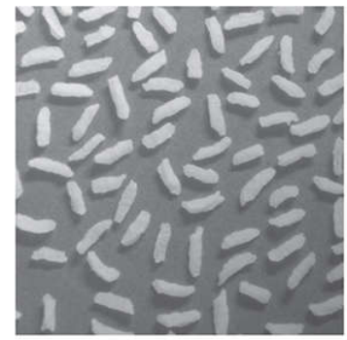
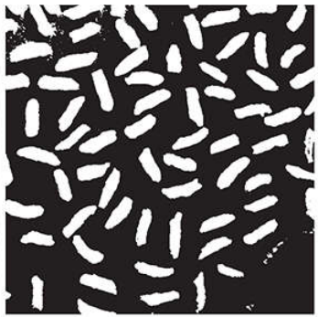
Thresholding
Light on dark bg?

Slide 51

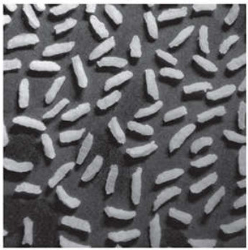
Opening
  SE radius 40
  Removes objects
  Leaves bg
Top-hat

Slide 52
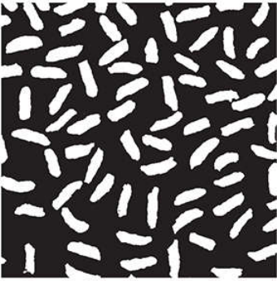
Opening
Top-hat

Slide 53
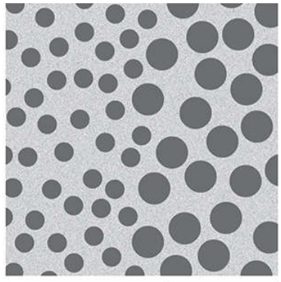
Textural Segmentation
Draw a border between textures
  Too many objects
Get rid of small circles
Spread the large circles

Slide 54
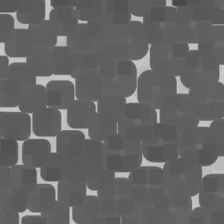
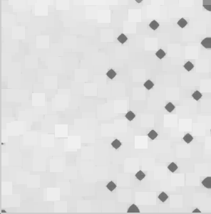
Erosion :
scipy.ndimage.gray_erosion(img,size(18,18))
Dilation scipy.ndimage.gray_dilation(img,size(18,18))

Slide 55

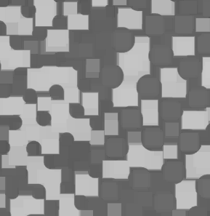
Closing :
scipy.ndimage.gray_closing(img,size(18,18))
Opening scipy.ndimage.gray_opening(img,size(18,18))

Slide 56

Closing → opening
scipy.ndimage.gray_closing(img,size(18,18))
mport scipy.ndimage as ndimage
import numpy as np
import cv2
img = cv2.imread('img.png')
img = cv2.cvtColor(img,cv2.COLOR_BGR2GRAY)
img2 = ndimage.grey_closing(img, size=(20,20))
img2 = ndimage.closing(img2, size=(30,30))
cv2.imshow("image",img2)
cv2.waitKey(0)

Slide 57


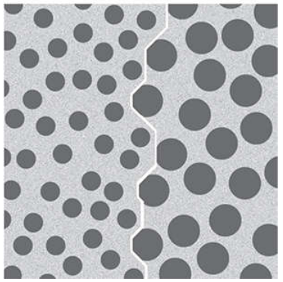
Textural Segmentation
Draw a border between textures
  Too many objects
Get rid of small circles
Spread the large circles
  Draw a boundary

Slide 58
Textural Segmentation
Dark objects on light background
Get rid of small circle
  Closing ?
    SE size?
Fill the gap or spread
  Opening ?
Draw a border
  Morphological gradient

Slide 59
Reference
9.1-9.5,9.8

Slide 60
Thankyou
Questions?

